Slide 1
Third eye: object recognition and speech generation for visually impaired
By - Yarlagadda Sai Bhavadeesh (2018BCS0082),
Peddi Shwejan (2018BCS0047), Allu Harsha Vardhan (2017BCS005), Lavanya S (2017BCS0034).
Guided by - Dr. Koppala Guravaiah

Slide 2
Introduction
Visually impaired people face a lot of difficulties in doing their daily activities. There is a say that, Out of all the five sense organs, eyes are most important.
Your eyesight is one of your most important senses: 80% of what we perceive comes through our sense of sight. [1]
Visually impaired need the help of either the third person or a stick. These methods are not always fruitful.
Detecting and recognizing the objects and generating speech about the objects helps visually impaired in a great way in understanding their surroundings.

Slide 3
Literature Survey
We have researched papers from four different years, from 2018 to 2021. We found that various technologies were used to develop this type of systems.
Here we are going to present those papers and discuss the improvements they achieved and difficulties they faced and how we are going to improve this system further.

Slide 4
Trends & Technologies… Survey...
Paper Title | Authors | Methods | Pros & Cons
Proposed System on Object Detection for Visually Impaired People.[2] | Rajwani, Roshan, Dinesh Purswani,Paresh Kalinani, Deesha Ramchandani, and Indu Dokare | Android Camera, OpenCV, Google Cloud Vision API, Compare it with Microsoft COCO Dataset and give output. | Since the output is through Android application,it should have enough battery.
A Highly Accurate and Reliable Data Fusion Framework for Guiding the Visually Impaired.[3] | Elmannai, Wafa M., and Khaled M. Elleithy. | Two camera Sensors, Computer Vision Methods, Oriented FAST and Rotated BRIEF (ORB) and KNN Algorithm. | Accuracy of 96%, Used a motherboard connected with various sensors like gyro, compass, GPS, music, FEZ Spider board.
3D Object Recognition of a Robotic Navigation Aid for the Visually Impaired.[4] | Ye, Cang, and Xiangfei Qian. | 3D Camera(White Cane),Planar Segments, Gaussian Model Mixture | Trained on all indoor objects Accuracy over 90%
Object Detection to Assist Visually Impaired People: A Deep Neural Network Adventure.[5] | Bashiri, Fereshteh S, Eric LaRose, Jonathan C. Badger, Roshan M. D’Souza, Zeyun Yu, and Peggy Peissig. | Marshfield Clinic Dataset,Google Glass Device,CNN Model,Support Vector Machine Algorithm | Limited number of objects(ex:doors,stairs,signs etc.,) Accuracy over 98%

Slide 5
Trends & Technologies… Survey… Contd...
JUVO - An Aid for the Visually Impaired[6] | Gianani, Sejal, Abhishek Mehta, Twinkle Motwani, and Rohan Shende | Camera,Image Capturing and Preprocessing,Object detection Using OpenCV SSD Framework MobileNet Architecture | Few objects in Dataset. Indoor Environment , Accuracy of 99.61%
Smart Cap-Wearable Visual Guidance System For Blind. [7] | Nishajith, A., J. Nivedha, Shilpa S. Nair, and J. Mohammed Shaffi. | Raspberry Pi Noir Camera, OpenCV Processing,COCO Model,eSpeak. | 90 classes of objects in Dataset.
Multisensor – based Object Detection in Indoor Environment for Visually Impaired People[8]. | Patel, Charmi T.,Vaidehi J. Mistry, Laxmi S. Desai, and Yogesh K. Meghrajani. | USB Webcam,Preprocessing,Statistical Analysis,SVM Classifier. | It can be used for outdoor environment but it is tested for indoor environment only
Real-Time Object Detection Application for Visually Impaired People: Third Eye.[9] | Tosun, Selman, and Enis Karaarslan. | Camera,OpenCV Processing,Tiny YOLO TensorFlow, Audio Output. COCO Dataset | Only 20 classes in the dataset, Manual selection.

Slide 6
Trends & Technologies… Survey… Contd...
Convolutional Neural Network for Object Detection System for Blind People.[10] | Y.C. Wong, J.A. Lai, S.S.S. Ranjit, A.R. Syafeeza, N. A. Hamid | Cnn,Used edge box algorithm, Caffnet model, softmax Cifar10 dataset has been used, | The object detection models faced difficulty in classifying the object from a picture of ultimate scale
Object Detection and Narrator for Visually Impaired People.[11] | Jawaid nasrren,warsi,Arif,Asad ali shaikh,Yahya Muhammad,Monaisha abdullah | Used YOLO.It narrates to the user.It was trained on Imagenet dataset | Results showed that the accuracy is varying depending on phone camera quality and the light effects. iPhone and Samsung have better results than others.
Smart Assistive Navigation Devices for Visually Impaired People.[12] | Arjun Pardasani, Prithviraj N Indi, Sashwata Banerjee, Aditya Kamal, Vaibhav Garg | Open CV, Image processing, Used Smart glass and shoes | Both the devices have been developed by using simple, cheap sensors. Their motive is to make both the devices as a part of the user's regular and frequently used objects
An Assistive Model for Visually Impaired People using YOLO and MTCNN.[13] | FerdousiRahman, IsratJahanRitun, NafisaFarhin, JiaUddin | Open CV, YOLO algorithm, Deep learning | The object detection process achieved 6-7 FPS processing with an accuracy rate of 63-80%

Slide 7
Trends & Technologies… Survey… Contd...
CNN based Auto-Assistance System as a Boon for Directing Visually Impaired Person.[14] | Samkit Shah , Jayraj Bandariya , Garima Jain , Mayur Ghevariya , Sarosh Dastoor | Haar cascade, CNN,Deep learning COCO 2017 data Set was used. | When processed on CPU, Haar cascade is the fastest algorithm, but CNN gives more accurate results when detecting multiple objects simultaneously for real time applications
Object Detection Using Convolution Neural Networks.[15] | Piyush Jhinkwan , Vaishali Ingale , Shubham Chaturvedi | Deep learning,CNN, Back propagation algorithm.For training CIFAR-100 dataset was used | It was trained with dropout and data augmentation to achieve better results.
A 68 mw 2.2 Tops/w low bit-width and multiplierless DCNN object detection processor for visually impaired people.[16] | Xiaobai Chen, Jinglong Xu | Deep convolutional network, low-bit, multiplierless, | reducing hardware cost by over 68% compared to the 16 bit fixpoint model with negligible accuracy loss
‘‘Watch Your Step’’: Precise Obstacle Detection and Navigation for Mobile Users Through Their Mobile Service.[17] | MINGHUI SUN PENGCHENG DING , JIAGENG SON , MIAO SONG5 , AND LIMIN WANG | Google Tango, built-in infrared (IR) sensor to collect data | The system cannot correctly distinguish complex situations such as obstacles leaning against a wall

Slide 8
Trends & Technologies… Survey… Contd...
Research on Small Target Detection in Driving Scenarios Based on Improved Yolo Network. [18] | Qiwei Xu, Runzi Lin, Han Yue, Hong Huang, Yun Yang, Zhigang Yao | YOLO v3, 2080 Ti machine, Dataset used is Apollo Scape (Baidu’s autopilot dataset). | Improvised YOLO v3 and it showed better results compared to YOLO v3. Accuracy is 84.76%.
Tinier-YOLO: A Real-Time Object Detection Method for Constrained Environments.[19] | Wei Fang, Lin Wang, Peiming Ren | Tinier-YOLO-v3, PASCAL VOC (2007 + 2012), COCO. | Faster runtime speed compared to other lightweight models. But, is suitable for embedded systems (Low accuracy).
YOLO-ACN: Focusing on Small Target and Occluded Object Detection.[20] | Yongjun Li, Shasha Li, Haohao Du, Lijia Chen, Dongming Zhang, Yao Li | YOLO-ACN, MS COCO, Infrared pedestrian dataset KAIST, NVIDIA Tesla K40. | Doesn’t improve performance much with the proposed method, compared to YOLO v3. focused on small objects detection.
Object Detection and Classification System for Visually Impaired.[21] | Rashika Joshi, Meenakshi Tripati, Amit Kumar, Manoj Singh Gaur. | MobileNetSSD (SSD - Single Shot-Detector), PASCAL VOC 2007. | Got pretty good accuracy, but the dataset is small, not sufficient. Only for embedded systems.

Slide 9
Trends & Technologies… Survey… Contd...
An Evaluation of RetinaNet on Indoor Object Detection for Blind and Visually Impaired Persons Assistance Navigation.[22] | Mouna Afif, Riadh Ayachi, Yahia Said, Edwige Pissaloux, Mohamed Atri | RetinaNet (ResNet, DenseNet, VGGNet based), Self prepared Dataset (Contains 8000 images). | Attained 84.61% mAP. Focused on only indoor navigation. the number of objects it can detect is very small. Got good results with proposed algorithm.
Indoor object detection and recognition for an ICT mobility assistance of visually impaired people. [23] | Mouna Afif, Riadh Ayachi, Edwige Pissaloux, Yahia Said, Mohamed Atri | YOLOv3, DarkNet-53. Dataset contains 8000 images and contains 16 indoor object classes. | Attained 73.19% mAP, and it’s only focused on indoor navigation. Used pretrained model and trained on the new dataset.
Robot Eye: Automatic Object Detection and Recognition Using Deep Attention Network to Assist Blind People.[24] | Ervin Yohannes, Paul Lin, Chih-Yang Lin, Timothy K. Shih | Self-designed model (DarkNet-53 based), ZED Stereo camera, PASCAL VOC, MS COCO datasets. | Accuracy is 81%, better than YOLO v3. Used PASCAL VOC for classes, and mixed MS COCO. No-of classes are too small
Deep Learning based Object Detection and Recognition Framework for the Visually-Impaired. [25] | Swapnil Bhole, Aniket Dhok | PASCAL VOC 2007 dataset, SSD, Inception v3 model. | Added currency detection to the dataset and achieved 90.2% acc. But the dataset contains only 20 classes.

Slide 10
Trends & Technologies… Survey… Contd...
IoT Enabled Automated Object Recognition for the Visually Impaired. [26] | Md. Atikur Rahman , Muhammad Sheikh Sadi | laser sensors , Single Shot Detector (SSD) model, SIFT,MS COCO dataset | Yolo accuracy is 95.99 and SSD 88.89%(YOLO) seems to be better compare to SSD
Deep Learning Technique Based Visually Impaired People Using YOLO V3 Framework Mechanism. [27] | Balachandar, Santhosh, Suriyakrishna, Vigensh, Usharani, Manju Bala | Yolov3,Cameras,M VOT,COCO dataset | They have used(videocon camera)its intra camera grahic.. which does not highlights the features properly and exactly tally the model
Real Time Object Detection with Audio Feedback using Yolo vs. Yolo_v3. [28] | Mansi Mahendru, Sanjay Kumar Dubey | Tensor flow, SSD, Yolo, Yolo_v3, gTTS, Deep Learning | Yolo accuracy is 78.99 and yolov3 92.89%(seems to be better compare to (yolo)
Guidance System for Visually Impaired People. [29] | Kanchan Patil , Avinash Kharat, Pratik Chaudhary , Shrikant Bidgar , Rushikesh Gavhane | gTTS, Yolo v3, Pyttsx, AIML, Vice over chatbot | chat-bot cannot recognize the command in noisy environment, chat-bot may get confused between voice of an user and person nearby.

Slide 11
Trends & Technologies… Survey… Contd...
Building A Voice Based Image Caption Generator with Deep Learning. [30] | Mohana priya R, Dr.Maria Anu, Divya | NLP ,CNN, LSTM (Long short term memory) ,RNN(recurrent neural network) flicker dataset,Accuracy 90% | The dataset is small. For better accuracy could be used big dataset , According to current trends, it’s not sufficient
Blind - Sight: Object Detection with Voice Feedback. [31] | A. Annapoorani, Nerosha Senthil Kumar, Dr. V. Vidhya | YOLO, COCO Dataset, gTTS | Live object recognition system cannot perform future learning which is a demerit.
Image Recognition and Voice Translation for Visually Impaired. [33] | Sandeep Pasupuleti, Lahari Dadi, Manikumar Gadi, R. Krishnaveni | Flickr_8k dataset, VGG, LSTM | Dataset is very small,the implementation can be enhanced by giving a greater number of images and text datasets with shorter captions for training

Slide 12
Trends & Technologies… Survey… Contd...
Hence, we took up this project to help visually impaired people to recognize their surroundings.
In recent years, deep learning has become more popular technique for solving these problems of identifying objects.
The deep learning systems achieve high accuracy rates at lower cost.
In this project we are planning to use YOLO v5 algorithm, which is more faster, more accurate, and light-weight compared to other versions of YOLO.
Planning to implement on benchmark datasets to attain good accuracy, and performance.
After detecting and recognizing the objects, we are planning to generate speech, for the recognized objects. This can be achieved by using Recurrent Neural Network Techniques (RNN).

Slide 13
Future work
Project is divided into two parts.
Object detection & recognition.
Image to speech generation.
Yarlagadda Sai Bhavadeesh, and Peddi Shwejan works on object detection & recognition.
Allu Harsha Vardhan, and Lavanya S works on image to speech generation.

Slide 14
References
[1]https://www.medicaleyecenter.com/2016/06/20/importance-eye-care/
[2]Rajwani, Roshan, Dinesh Purswani, Paresh Kalinani, Deesha Ramchandani, and Indu Dokare. "Proposed system on object detection for visually impaired people." International Journal of Information Technology (IJIT) 4.1 (2018): 1-6.
[3]Elmannai, Wafa M., and Khaled M. Elleithy. "A highly accurate and reliable data fusion framework for guiding the visually impaired." IEEE Access 6 (2018): 33029-33054.
[4]Ye, Cang, and Xiangfei Qian. "3-D object recognition of a robotic navigation aid for the visually impaired." IEEE Transactions on Neural Systems and Rehabilitation Engineering 26.2 (2017): 441-450.
[5]Bashiri, Fereshteh S.,Eric LaRose, Jonathan C. Badger, Roshan M. D’Souza, Zeyun Yu, and Peggy Peissig. "Object detection to assist visually impaired people: A deep neural network adventure." International Symposium on Visual Computing. Springer, Cham, 2018.
[6]Gianani, Sejal, Abhishek Mehta, Twinkle Motwani, and Rohan Shende. "JUVO-An Aid for the Visually Impaired." 2018 International Conference on Smart City and Emerging Technology (ICSCET). IEEE, 2018.
[7]Nishajith, A., J. Nivedha, Shilpa S. Nair, and J. Mohammed Shaffi. "Smart cap-wearable visual guidance system for blind." 2018 International Conference on Inventive Research in Computing Applications (ICIRCA). IEEE, 2018.
[8]Patel, Charmi T.,Vaidehi J. Mistry, Laxmi S. Desai, and Yogesh K. Meghrajani. "Multisensor-based object detection in indoor environment for visually impaired people." 2018 Second International Conference on Intelligent Computing and Control Systems (ICICCS). IEEE, 2018.
[9]Tosun, Selman, and Enis Karaarslan. "Real-Time Object Detection Application for Visually Impaired People: Third Eye." 2018 International Conference on Artificial Intelligence and Data Processing (IDAP). Ieee, 2018.
[10]Wong, Y. C., J. A. Lai, S. S. S. Ranjit, A. R. Syafeeza, and N. A. Hamid."Convolutional neural network for object detection system for blind people." Journal of Telecommunication, Electronic and Computer Engineering (JTEC) 11.2 (2019): 1-6.
[11]Nasreen, Jawaid, Warsi Arif, Asad Ali Shaikh, Yahya Muhammad, and Monaisha Abdullah."Object Detection and Narrator for Visually Impaired People." 2019 IEEE 6th International Conference on Engineering Technologies and Applied Sciences (ICETAS). IEEE, 2019.

Slide 15
Contd...
[12]Pardasani, Arjun, Prithviraj N. Indi, Sashwata Banerjee, Aditya Kamal, and Vaibhav Garg. "Smart assistive navigation devices for visually impaired people." 2019 IEEE 4th International Conference on Computer and Communication Systems (ICCCS). IEEE, 2019.
[13]Rahman, Ferdousi, Israt Jahan Ritun, Nafisa Farhin, and Jia Uddin."An assistive model for visually impaired people using YOLO and MTCNN." Proceedings of the 3rd International Conference on Cryptography, Security and Privacy. 2019.
[14]Shah, Samkit, Jayraj Bandariya, Garima Jain, Mayur Ghevariya, and Sarosh Dastoor."CNN based auto-assistance system as a boon for directing visually impaired person." 2019 3rd International Conference on Trends in Electronics and Informatics (ICOEI). IEEE, 2019.
[15]Jhinkwan, Piyush, Vaishali Ingale, and Shubham Chaturvedi. "Object Detection Using Convolution Neural Networks." Proceedings of International Conference on Communication and Information Processing (ICCIP). 2019.
[16]Chen, Xiaobai, Jinglong Xu, and Zhiyi Yu. "A 68-mw 2.2 Tops/w Low Bit Width and Multiplierless DCNN Object Detection Processor for Visually Impaired People." IEEE Transactions on Circuits and Systems for Video Technology 29.11 (2018): 3444-3453.
[17]Sun, Minghui, Pengcheng Ding, Jiageng Song, Miao Song, and Limin Wang. "“Watch Your Step”: Precise Obstacle Detection and Navigation for Mobile Users Through Their Mobile Service." IEEE Access 7 (2019): 66731-66738.
[18]Xu, Qiwei, Runzi Lin, Han Yue, Hong Huang, Yun Yang, and Zhigang Yao. "Research on small target detection in driving scenarios based on improved yolo network." IEEE Access 8 (2020): 27574-27583.
[19]Fang, Wei, Lin Wang, and Peiming Ren. "Tinier-YOLO: A real-time object detection method for constrained environments." IEEE Access 8 (2019): 1935-1944.
[20]Li, Yongjun, Shasha Li, Haohao Du, Lijia Chen, Dongming Zhang, and Yao Li. "YOLO-ACN: Focusing on Small Target and Occluded Object Detection." IEEE Access 8 (2020): 227288-227303.
[21]Joshi, Rashika, Meenakshi Tripathi, Amit Kumar, and Manoj Singh Gaur. "Object Recognition and Classification System for Visually Impaired." 2020 International Conference on Communication and Signal Processing (ICCSP). IEEE, 2020.

Slide 16
Contd...
[22]Afif, Mouna, Riadh Ayachi, Yahia Said, Edwige Pissaloux, and Mohamed Atri. "An evaluation of retinanet on indoor object detection for blind and visually impaired persons assistance navigation." Neural Processing Letters (2020): 1-15.
[23]Afif, Mouna, Riadh Ayachi, Edwige Pissaloux, Yahia Said, and Mohamed Atri. "Indoor objects detection and recognition for an ICT mobility assistance of visually impaired people." Multimedia Tools and Applications 79.41 (2020): 31645-31662.
[24]Yohannes, Ervin, Paul Lin, Chih-Yang Lin, and Timothy K. Shih. "Robot Eye: Automatic Object Detection And Recognition Using Deep Attention Network to Assist Blind People." 2020 International Conference on Pervasive Artificial Intelligence (ICPAI). IEEE, 2020.
[25]Bhole, Swapnil, and Aniket Dhok. "Deep Learning based Object Detection and Recognition Framework for the Visually-Impaired." 2020 Fourth International Conference on Computing Methodologies and Communication (ICCMC). IEEE, 2020.
[26]Rahman, Md Atikur, and Muhammad Sheikh Sadi. "IoT Enabled Automated Object Recognition for the Visually Impaired." Computer Methods and Programs in Biomedicine Update (2021): 100015.
[27]Balachandar, A., et al.Santhosh, Suriyakrishna, Vigensh, Usharani, Manju Bala "Deep Learning Technique Based Visually Impaired People Using YOLO V3 Framework Mechanism." 2021 3rd International Conference on Signal Processing and Communication (ICPSC). IEEE, 2021.
[28]Mahendru, Mansi, and Sanjay Kumar Dubey. "Real Time Object Detection with Audio Feedback using Yolo vs. Yolo_v3." 2021 11th International Conference on Cloud Computing, Data Science & Engineering (Confluence). IEEE, 2021.
[29]Patil, Kanchan,Avinash Kharat, Pratik Chaudhary , Shrikant Bidgar , Rushikesh Gavhane et al. "Guidance System for Visually Impaired People." 2021 International Conference on Artificial Intelligence and Smart Systems (ICAIS). IEEE, 2021.
[30]Anu, Maria, and S. Divya. "Building A Voice Based Image Caption Generator with Deep Learning." 2021 5th International Conference on Intelligent Computing and Control Systems (ICICCS). IEEE, 2021.
[31]Annapoorani, A., Nerosha Senthil Kumar, and V. Vidhya. "Blind-Sight: Object Detection with Voice Feedback." (2021).
[32]Pasupuleti, Sandeep,Lahari Dadi, Manikumar Gadi, R. Krishnaveni et al. "Image Recognition and Voice Translation for Visually Impaired." International Journal of Research in Engineering, Science and Management 4.5 (2021): 18-23.

Slide 17
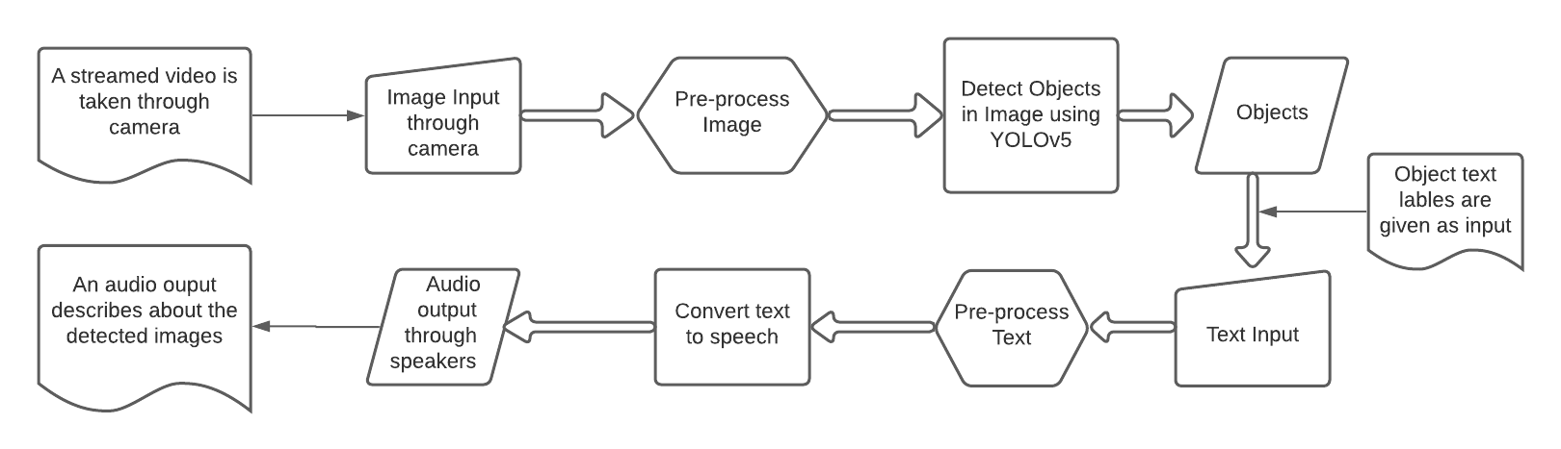
Project Overview

Slide 18
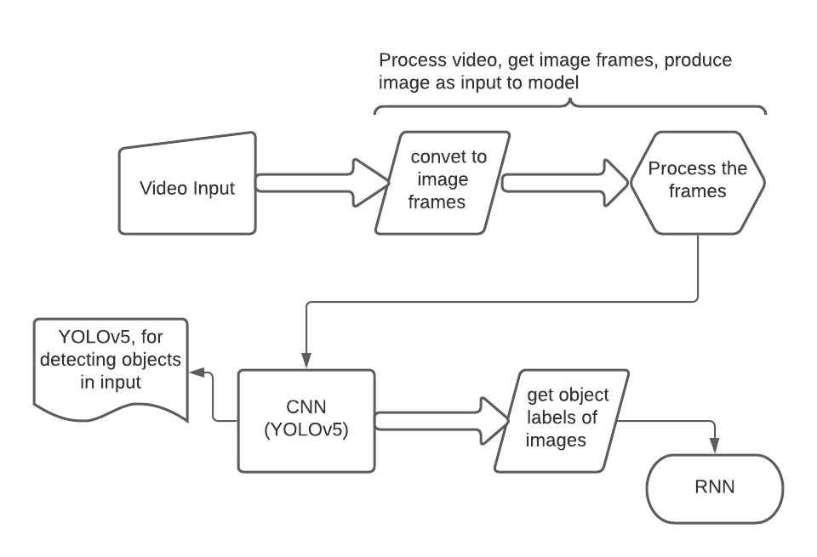
Phase - 1, Overview

Slide 19
What is YOLO
YOLO an acronym for 'You only look once', is an object detection algorithm that focuses on detecting objects in images which divides images into a grid system.
Each cell in the grid is responsible for detecting objects within itself.
Yolo V5 is one of the best available models for Object Detection at the moment.
The great thing about this Deep Neural Network is that it is very easy to retrain the network on your own custom dataset.

Slide 20
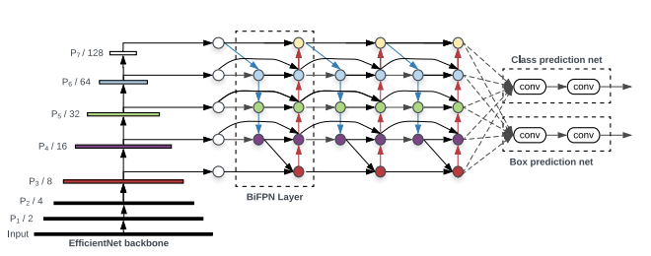
Architecture - YOLO v5
The network architecture of YOLO v5. It consists of three parts:
Backbone: CSPDarknet
Neck: PANet
Head: Yolo Layer
The data are provided to CSPDarknet for feature extraction.
Further fed into PANet for feature fusion.
Yolo Layer outputs detection results

Slide 21
Dataset
MS COCO Dataset + Custom Dataset
MS COCO Dataset (80 Objects)
It features a large-scale object detection, segmentation, and captioning.
Custom Dataset
15 more objects, apart from 80 COCO dataset objects (person, dog, umbrella, hand bag, suitcase, chair, bed, etc...).
Labels: switchboard, pillow, locker, keys, open door, closed door, window, direction board, postbox, pole, shop, manhole, tree, upstairs, downstairs
Added 400+ Images to Train set, and 80+ images to Validation set.

Slide 22
Contd...
Data annotation
To train on new dataset, we first need to annotate the images.
Lot of online tools are available to annotate images.
New dataset is annotated using makesense.ai.
Makesense.ai is chosen, because of its flexibility towards our work.
YOLO format
For training on YOLO, we need to have following file structure.
Root folder
Images
Train
Val
Test
Labels
Train
Val
Train.txt
Val.txt
Test.txt

Slide 23
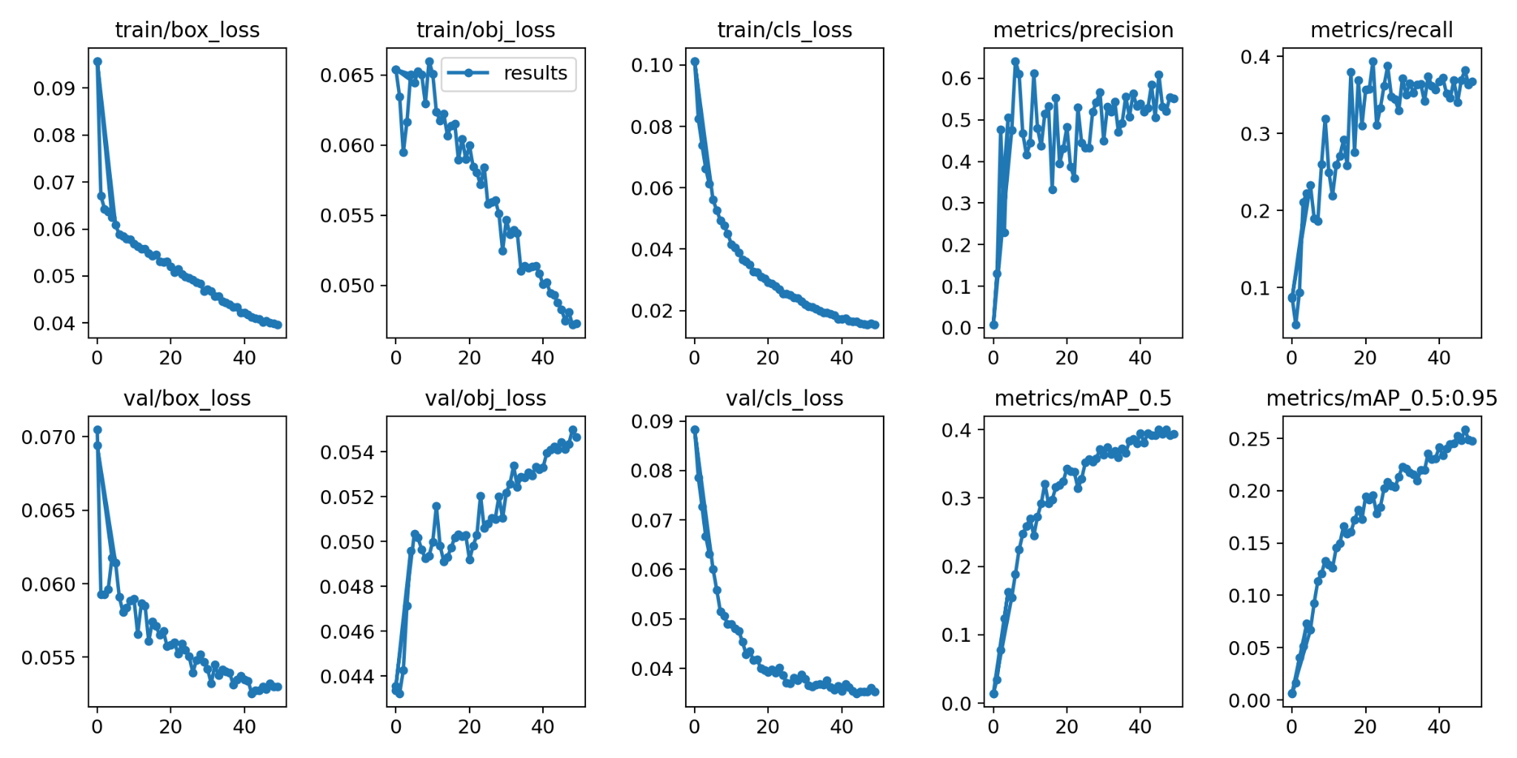
Experimental Results
We have achieved pretty good results with our model.

Slide 24
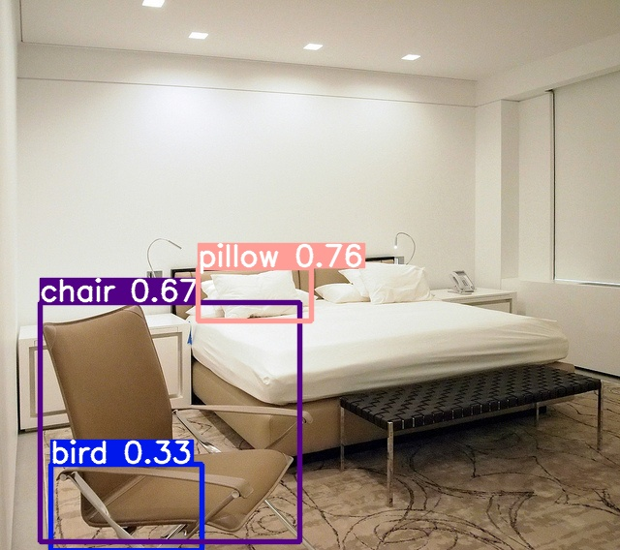
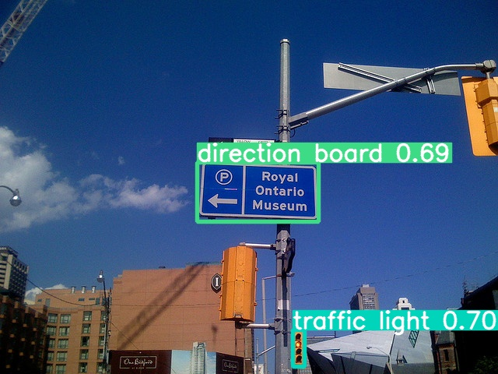
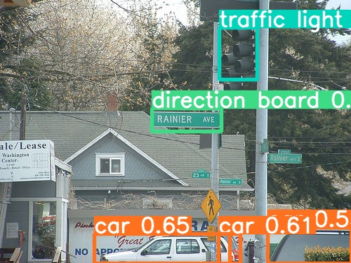
Contd...
Few examples,
Model is able to detect properly on custom
Dataset (newly added objects).

Slide 25
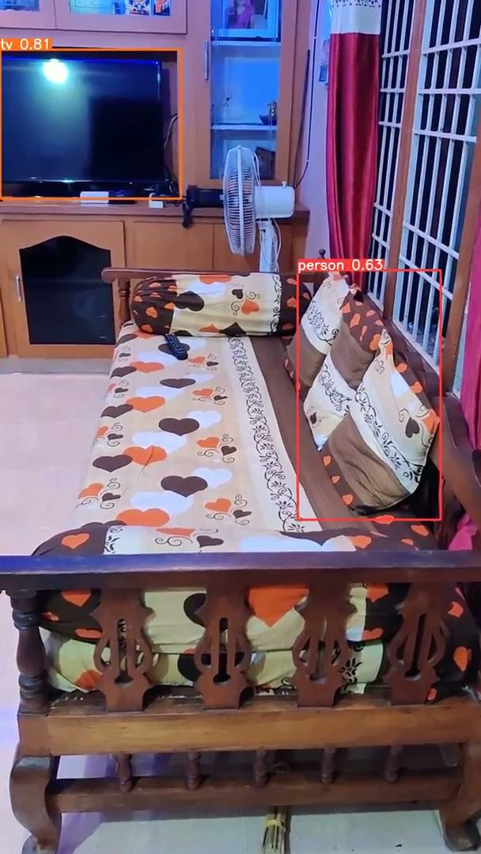
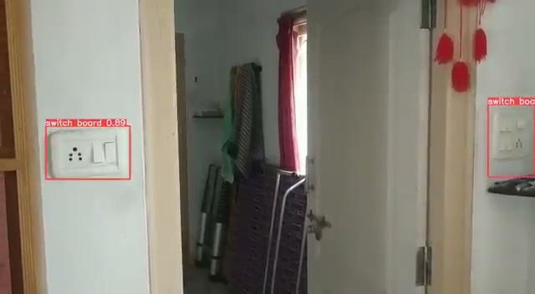
Object detection on a sample video

Slide 26
Future work
Improvising accuracy of current work.
Transfer outputs of YOLO v5 model to inputs of speech conversion model.
Train a model to convert text to speech.

Slide 27
References
[1] Tan, Mingxing, Ruoming Pang, and Quoc V. Le. "Efficientdet: Scalable and efficient object detection." Proceedings of the IEEE/CVF conference on computer vision and pattern recognition. 2020.

Slide 28
Introduction
Project - Phase 1 and Phase 2
Phase 1 constitutes of training a model which takes images through a camera as input, it detects the objects found in the images and object’s text labels are given as output.
Used YOLOv5 for Phase 1.
Phase 2 constitutes of using the object’s text labels as input to a model which converts text to speech and the speech is given as output.
Text to speech conversion libraries:
Google Text to Speech (gTTS)
pyttsx3 (text to speech conversion library in python)

Slide 29
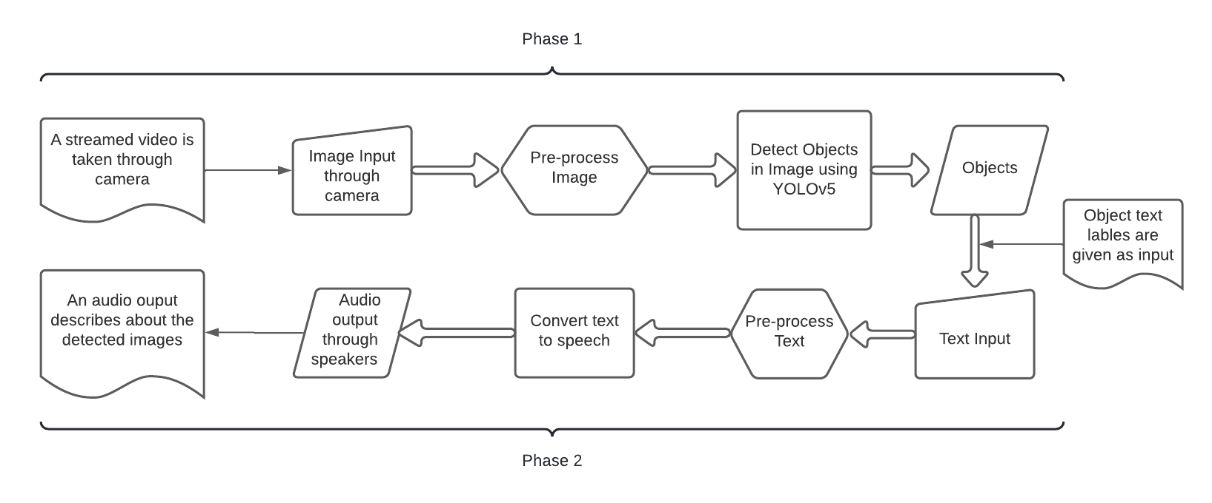
Project Overview

Slide 30
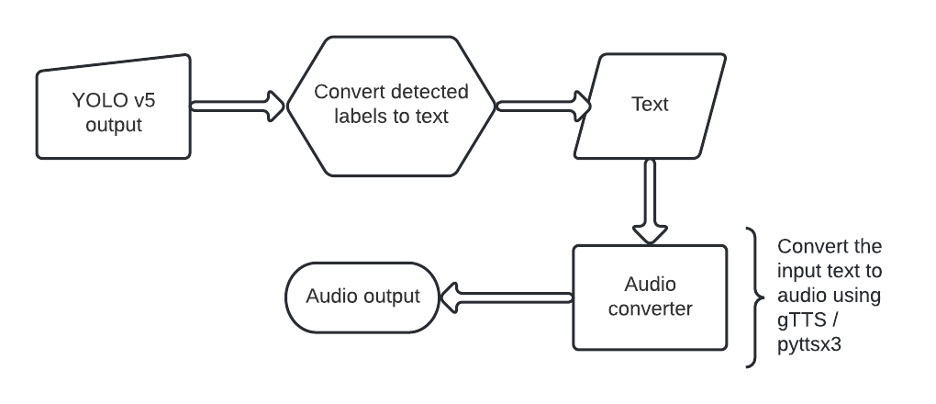
Phase - 2, Overview

Slide 31
gTTS
gTTS is a tool which converts the text entered, into audio which can be saved as a mp3 file. [3]
The gTTS API supports several languages including English, Hindi, Tamil, French, German and many more
Features
Customizable speech-specific sentence tokenizer that allows for unlimited lengths of text to be read, all while keeping proper intonation, abbreviations, decimals and more;
Customizable text pre-processors which can, for example, provide pronunciation corrections.

Slide 32
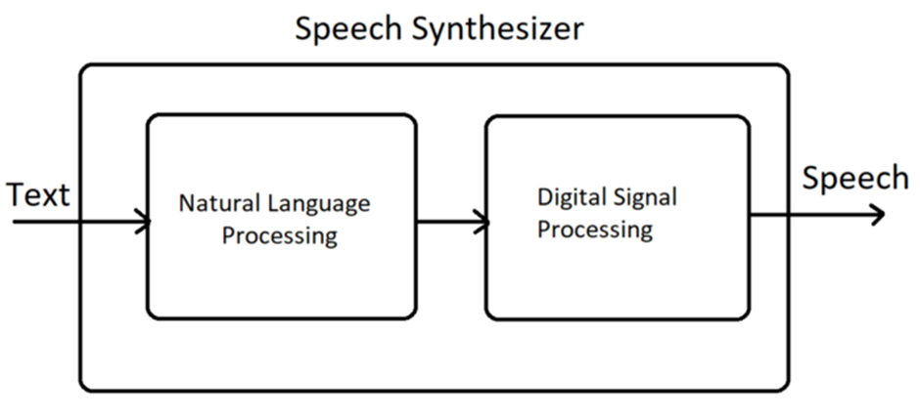
Synthesizing of speech block diagram
Figure: Synthesizing of speech block diagram [2]

Slide 33
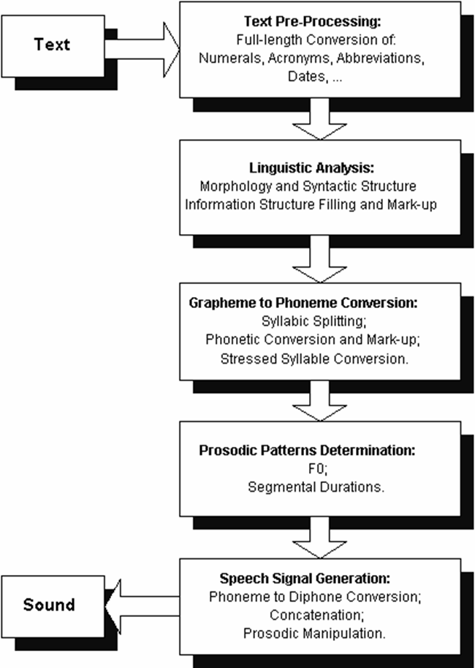
gTTS Architecture
Figure: gTTS Architecture [1]

Slide 34
pyttsx3
pyttsx3 is a text-to-speech conversion library in Python. Unlike alternative libraries, it works offline and online, and is compatible with both Python 2 and 3 versions.
We can also change the voice of the engine.
We can also change the Speed of the Speech Engine.
The Default Speed Rate of the Speech Engine is 200.
If we set the Speed below 200 the voice will speak slowly and above 200 will increase the speed rate of the engine.
It supports several languages that is unicode.

Slide 35
Workflow
pyttsx3.init()
When an application invokes pyttsx3 it get initialised and an object of pyttsx3.driver function is created.
pyttsx3.init([driverName : string, debug : bool]) → pyttsx3.Engine
Driver names will be according as given below.
Name of the pyttsx3.drivers module to load and use. Defaults to the best available driver for the platform, currently:
sapi5 - SAPI5 on Windows
nsss - NSSpeechSynthesizer on Mac OS X
espeak - eSpeak on every other platform

Slide 36
Workflow contd…
getProperty(name : string)
Here the name to the name of the property
rate
Integer speech rate in words per minute. Defaults to 200 word per minute.
voice
String identifier of the active voice.
voices
List of pyttsx3.voice.Voice descriptor objects.
volume
Floating point volume in the range of 0.0 to 1.0 inclusive. Defaults to 1.0

Slide 37
Workflow contd…
setProperty(name, value)
rate
Integer speech rate in words per minute.
voice
String identifier of the active voice.
volume
Floating point volume in the range of 0.0 to 1.0 inclusive.

Slide 38
Workflow contd…
For voice Property we can do some customization like as
age
Integer age of the voice in years. Defaults to None if unknown.
gender
String gender of the voice: male, female, or neutral. Defaults to None if unknown.

Slide 39
Workflow contd…
languages
List of string languages supported by this voice. Defaults to an empty list of unknown.
Now the voice engine ready to take input of text:
engine.say()
used to speak out the engine
engine.runAndWait()
Used to run the engine with the given input and wait for the next input if it
is loop else it will break.

Slide 40
Observations
gTTS work online unlike pyttsx3. [4]
gTTS requires an active internet connection.
gTTS sends text to Google’s servers to generate a speech file, which is then returned.
pyttsx3 doesn’t require any internet connection. It works offline.
The speech generated by pyttsx3 is spoken a little faster than gTTS speech.
Time taken to provide audio by pyttsx3 is less than the time taken by gTTS.
gTTS also needs an external package to output the audio file created, whereas pyttsx3 has inbuilt functions to play the audio created by it.[3]

Slide 41
Conclusion
We found pyttsx3 more helpful than gTTS, considering the time taken to produce audio, and the delay in frames.
We are planing to implement image to speech using gTTS and pyttsx3.
We try to improve the model accuracy and try to get better results on the detection.
We also try to prototype the project by making a physical wearable device.

Slide 42
References
[1] https://www.goeduhub.com/10597/text-to-speech-conversion-in-python-gtts
[2] https://towardsdatascience.com/how-to-get-started-with-google-text-to-speech-using-python-485e43d1d544
[3] https://towardsdatascience.com/object-detection-with-voice-feedback-yolo-v3-gtts-6ec732dca91
[4] https://medium.com/@ashwinijha006/zen-of-python-the-hard-way-is-easier-b3ab7644571a#:~:text=gTTS%20(Google%20Text%2Dto%2D,text%2Dto%2Dspeech%20API.&text=pyttsx3%20is%20a%20text%2Dto,both%20Python%202%20and%203.
[28] Mahendru, Mansi, and Sanjay Kumar Dubey. "Real Time Object Detection with Audio Feedback using Yolo vs. Yolo_v3." 2021 11th International Conference on Cloud Computing, Data Science & Engineering (Confluence). IEEE, 2021.
[31] Annapoorani, A., Nerosha Senthil Kumar, and V. Vidhya. "Blind-Sight: Object Detection with Voice Feedback." (2021).
[32] Pasupuleti, Sandeep,Lahari Dadi, Manikumar Gadi, R. Krishnaveni et al. "Image Recognition and Voice Translation for Visually Impaired." International Journal of Research in Engineering, Science and Management 4.5 (2021): 18-23.

Slide 43
Thank you

